Slide 1

PREDICTING NURSING HOME COVID CASES
Jackson Hassell, Yash Warty, Raymond Li, Emma Sun, Yashaswini Kalva

Slide 2
TABLE OF CONTENTS
01
02
03
Introduction
Data Exploration
Data Cleaning
03
04
Data Modeling
Conclusion

Slide 3
01
Introduction

Slide 4
COVID-19 In the United States
Total Cases
Deaths
Timeline
Vaccinations
82 Million cases and counting
1 Million deaths and counting
First case on Jan 20th, severe restrictions imposed March 2020
66% of population fully vaccinated, 572M doses given

Slide 5
TMF Health Quality Institute
Regions Served
Areas Covered
Services Offered
Clients
TX, AR, NE, MS, PR, VI
Opioids, immunization, testing, training, infection control
Learning and Dissemination, Monitoring, Assistance and Training
Federal Agencies, Nursing Homes, Community Organizations

Slide 6
Project Aim
Identifying nursing home traits that predict a high likelihood of a Covid-19 outbreak

Slide 7
02
Data Exploration

Slide 8
Datasets Summary
Nursing Home Dataset
1,513,256 observations with 183 features
Provider Dataset
15,216 observations with 96 features

Slide 9
Feature Analysis
32% of features in the combined dataset have more than 50% of the values missing
Shortage of Staff/Supplies
Shortage of Nursing Staff - 18%
Shortage of Aides - 20.4%
Shortage of Clinical Staff -2.3%
1.68% missing data for these features

Slide 10
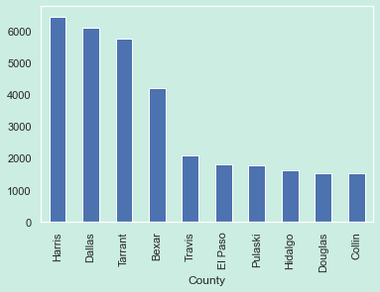
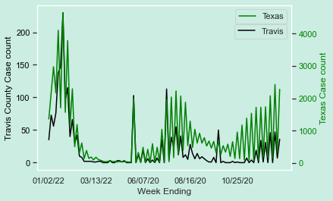
Feature Exploration
County’s from 6 states
Texas State Vs Travis County

Slide 11
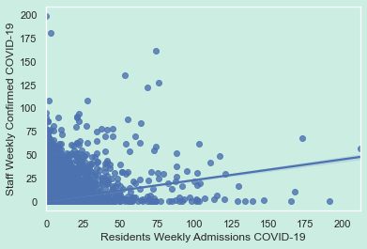
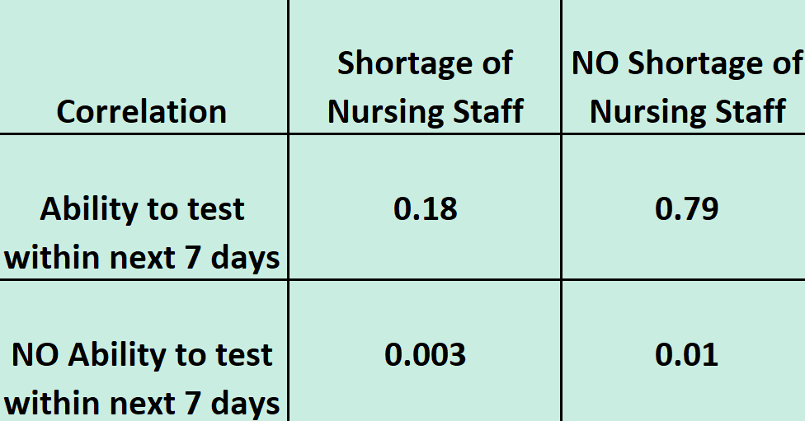
Feature Exploration on Staff
Travis County
Weak Correlation(0.15) between Residents and Staff affected with COVID-19
Shortage of Nursing staff did not hinder COVID-19 testing

Slide 12
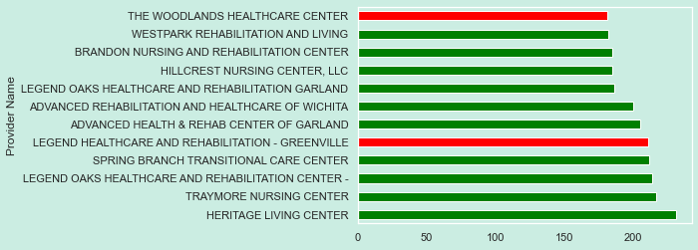
Feature Exploration on Shortage
Shortage of Nursing Staff and Aides
Red bar- Shortage
Green bar- No shortage
1 in 5 clinics have shortage of Nursing Staff and Aides

Slide 13
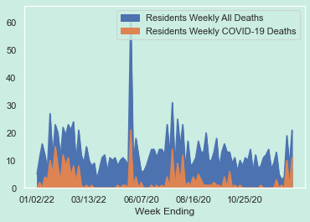
Feature Exploration of Travis County
Deaths in Travis County

Slide 14
03
Data Cleaning

Slide 15
First Issue: Missing Values
45%
Nearly half of the values in our dataframe are missing.
Every single row has at least one missing value.

Slide 16
Solution: Interpolation
Filling in missing values based on guesses.
But…
Interpolation doesn’t work as well when there are too many missing values.
Solution: drop all columns with more than 50% missing values.

Slide 17
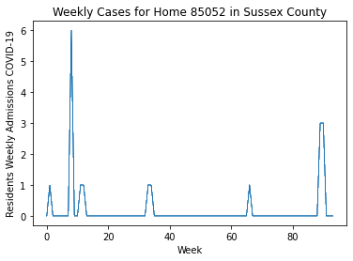
Second Issue: Zero Case Weeks
86%
Most weeks, most homes had no covid cases.
We’re asking our models to predict when the first covid case in weeks happens, which is nearly random.

Slide 18
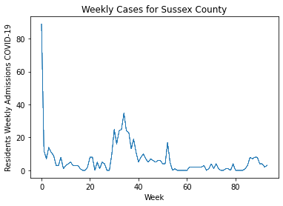
Solution: Aggregation
Combine all homes in each county.
Average number of covid cases per week goes from .7 to 6.2
Much easier for our models to predict!

Slide 19
Data Encoding
We still need to take advantage of the time series structure of our data.
Add lag versions of each predictor, showing the values for that predictor last few weeks in the same county.
The future depends on the past!

Slide 20
04
Data Modeling

Slide 21

Modelling Techniques
For a large dataset like ours, there are lots of options for predicting the number of cases.
SIR Model
Linear Regression (Ridge, Lasso)
Neural Networks
Ensemble Methods
We tried and evaluated all models with cross-validation using RMSE as our metric.

Slide 22



SIR Model
Susceptible
Infectious
Removed
Compartmental model for infectious disease spread like COVID-19
Uses a system of differential equations to predict future trends (based on time-series data)
Total # of nursing home patients
# of Active Covid-19 cases per week
# of recovered patients per week
Performs very poorly with our data (9% R-squared); Due to peaks and troughs/gaps in data

Slide 23


Key Takeaways
Explainability
Performance
Model Choice
Linear models more explainable than complex models
Linear Models perform better than complicated Models
Lasso: Most explainable, built-in feature selection for important parameters
 | Ridge | Lasso | Decision Tree | Bagging Regressor | Basic Neural Net | Recurrent Neural Net | LSTM Neural Net
RMSE | 9.74 | 10.05 | 14.63 | 9.96 | 15.35 | 163.97 | 36.16

Slide 24


Model Improvements
Time-Series Split
Cluster Labels
Creates 5 different cross-validation sets for train/test and ensures consistency
Used a function to create cluster labels for each home to use in one-hot encoding
Improves training accuracy
Improves model performance

Slide 25
05
Conclusion

Slide 26
Important Features
Coefficient | Feature
8.74 | Resident Cases 1 Week Ago
6.70 | Staff Cases 1 Week Ago
3.56 | 3 Or More Total Cases 1 Week Ago
1.46 | Resident Positive Covid Tests 1 Week Ago
1.13 | Initial Covid Cases 1 Week Ago
.66 | Resident Positive Covid Tests 1 Week Ago (PCR Only)
.33 | Initial Covid Cases 2 Weeks Ago
.06 | Initial Covid Cases 3 Weeks Ago
As expected, the number of cases this week is largely determined by the number of cases in the previous 3 weeks.
You can get within 10 cases per county per week with just these features!
Implies features TMF was worried about, like shortage of staff, ultimately aren’t very important in determining Covid cases.

Slide 27
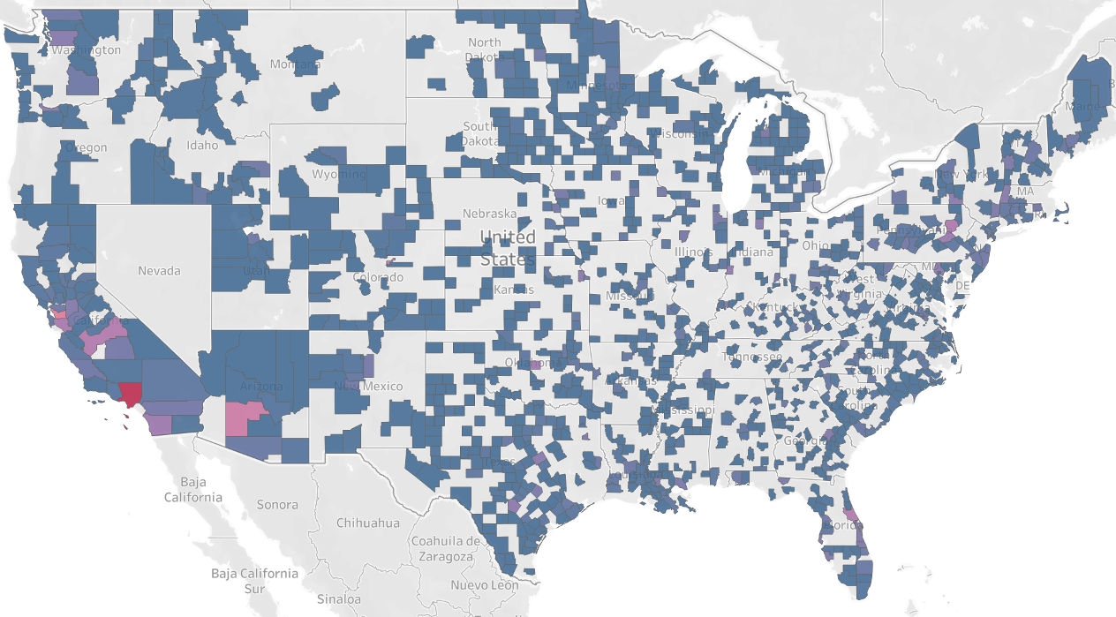
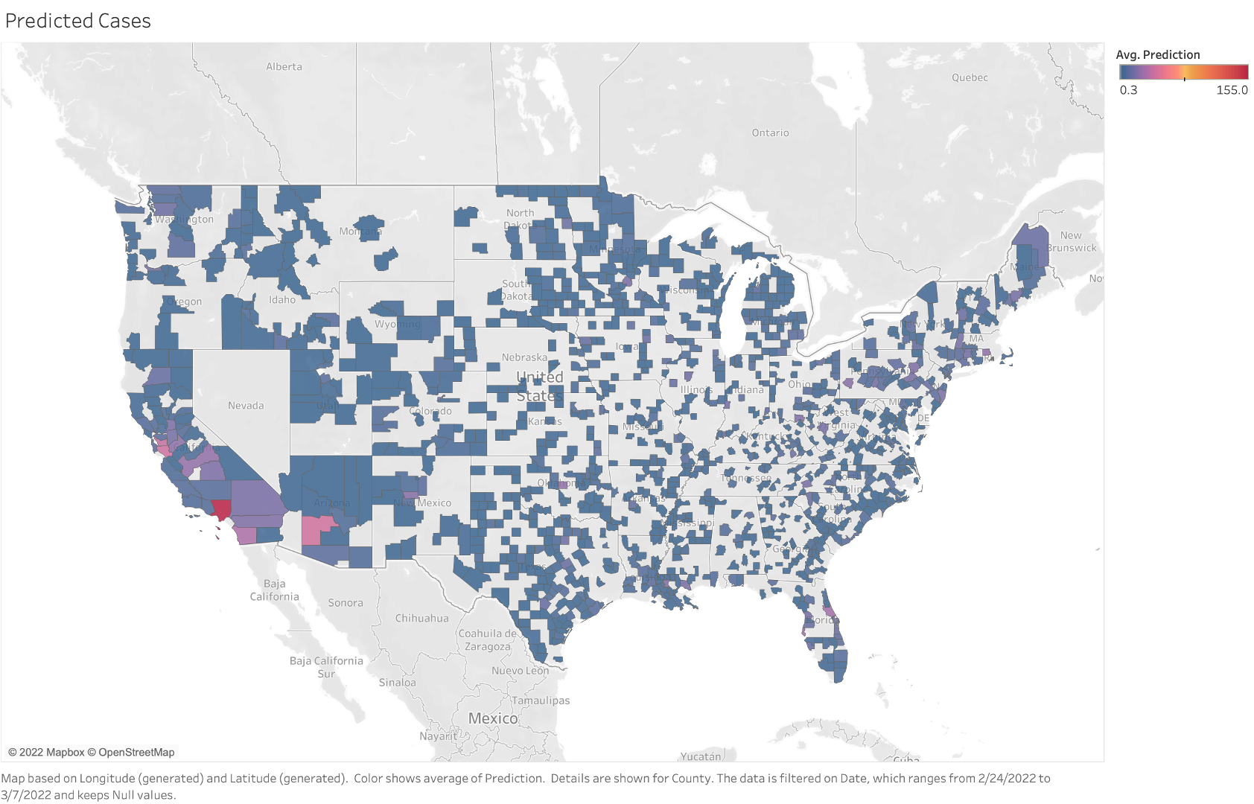
Visualizing Results
Actual Cases
Predicted Cases
Nearly identical!

Slide 28
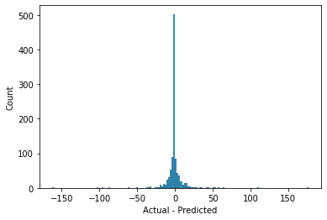
Visualizing Results
Model doesn’t tend to overpredict or underpredict on average.
Most residuals are extremely small

Slide 29
Further Improvements
Currently, our model does a good job at predicting county-level Covid cases.
However, in some cases it may be necessary to be more granular with our predictions.
Perhaps home-level predictions can be achieved through greater feature engineering and bringing in more outside data sources.

Slide 30
Thanks for Listening! Any questions?

